Slide 1
Homework 5 “User interfaces for my character”
Date: July 14, 2023 10PM
PREAP CHANDAVIN

Slide 2
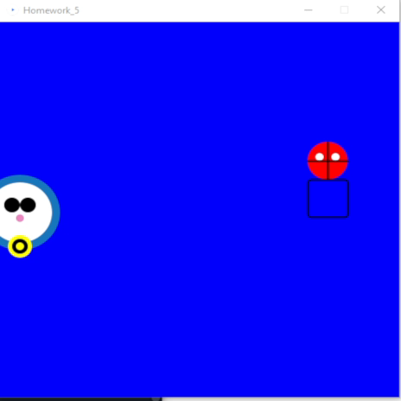
Today i will take my old both character for make action by using arrow key ‘w’ ‘a’ ‘s’ ‘d’ & mouse courser spiderman & doraemon
My spiderman moves by the keyboard. Key ‘w’ ‘a’ ‘s’ ‘d’.and doraemon control by mouse
Program sources GitHub
https://github.com/Vinvin23/Characteraction-vin/tree/main

Slide 3
Source code
//Main
float x,y;
float a,b;
void setup() {
size (500, 500);
x = 100;
y = 200;
a = b = 300;
}
void draw(){
background(0,0,250 );
doraemon(x,y,5);
spider(a,b,5);
x = mouseX;
y = mouseY;
if(keyPressed){
if(key == 'd') a += 5; // right
else if(key == 'a') a -= 5; // to left
else if(key == 'w') b -= 5; // to up
else if(key == 's') b += 5; // down
}
}
//Doraemon
void doraemon(float x, float y, float d)
{
//BG
// Doraemon's body
fill(23, 118, 187);
noStroke();
ellipse(x, y, 20*d, 20*d);
// Doraemon's face
fill(255);
ellipse(x, y, 16*d, 16*d);
// Doraemon's eyes
fill(0);
ellipse(x -2*d, y -2*d, 4*d, 4*d);
ellipse(x +2*d, y -2*d, 4*d, 4*d);
// Doraemon's nose
fill(236, 135, 192);
ellipse(x, y +1.5*d, 2*d, 2*d);
// Doraemon's bell
fill(255, 255, 0);
noStroke();
ellipse(x, y +9*d, 6*d, 6*d);
fill(0);
ellipse(x, y +9*d, 4*d, 4*d);
fill(255, 255, 0);
ellipse(x, y +9*d, 2*d, 2*d);
}
//spiderman
void spider(float x, float y, float d)
{
// Draw Spiderman's head
fill(255, 0, 0); // Set the fill color to red
ellipse(x, y, 10*d, 10*d); // Draw a red circle for the head
// Draw Spiderman's eyes
fill(255); // Set the fill color to white
ellipse(x - 2*d, y - d, 2*d, 2*d); // Draw the left eye
ellipse(x + 2*d, y - d, 2*d, 2*d); // Draw the right eye
// Draw Spiderman's web
stroke(0); // Set the stroke color to black
strokeWeight(2); // Set the stroke weight to 2 pixels
line(x - 5*d, y, x + 5*d, y); // Draw the horizontal line of the web
line(x, y - 5*d, x, y + 5*d); // Draw the vertical line of the web
// Draw Spiderman's body
fill(0, 0, 255); // Set the fill color to blue
rect(x - 5*d, y + 5*d, 10*d, 10*d, d); // Draw a blue rectangle for the body
}

Slide 4
My feeling
I'm excited about this lesson as it's part of getting closer to creating your own game.

